Slide 1



SECURITY VAULT

Slide 2
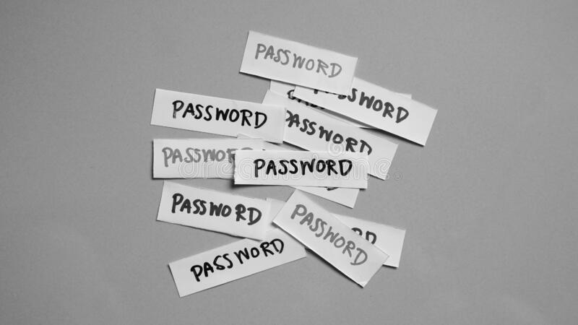

PROJECT DESCRIPTION
The project will be comprising of a GUI window which will be produced after executing the code. The GUI will be created using Swing Libraries .This Project will be having the following components :-
A Log-in Window which will only work if correct credentials have been entered by the user. These credentials will already be provided beforehand.
Afterwards a Second Window will open, where there will be options to Add , Search & filter passwords respectively.
On Clicking Add “New Password” , There will be a window where there will be options to input information of the account.
While typing in the Search Bar, the password saved related to the input content will be shown accordingly.
Furthermore, there will be Two-time confirmation of passwords to increase precise input of the passwords.

Slide 3
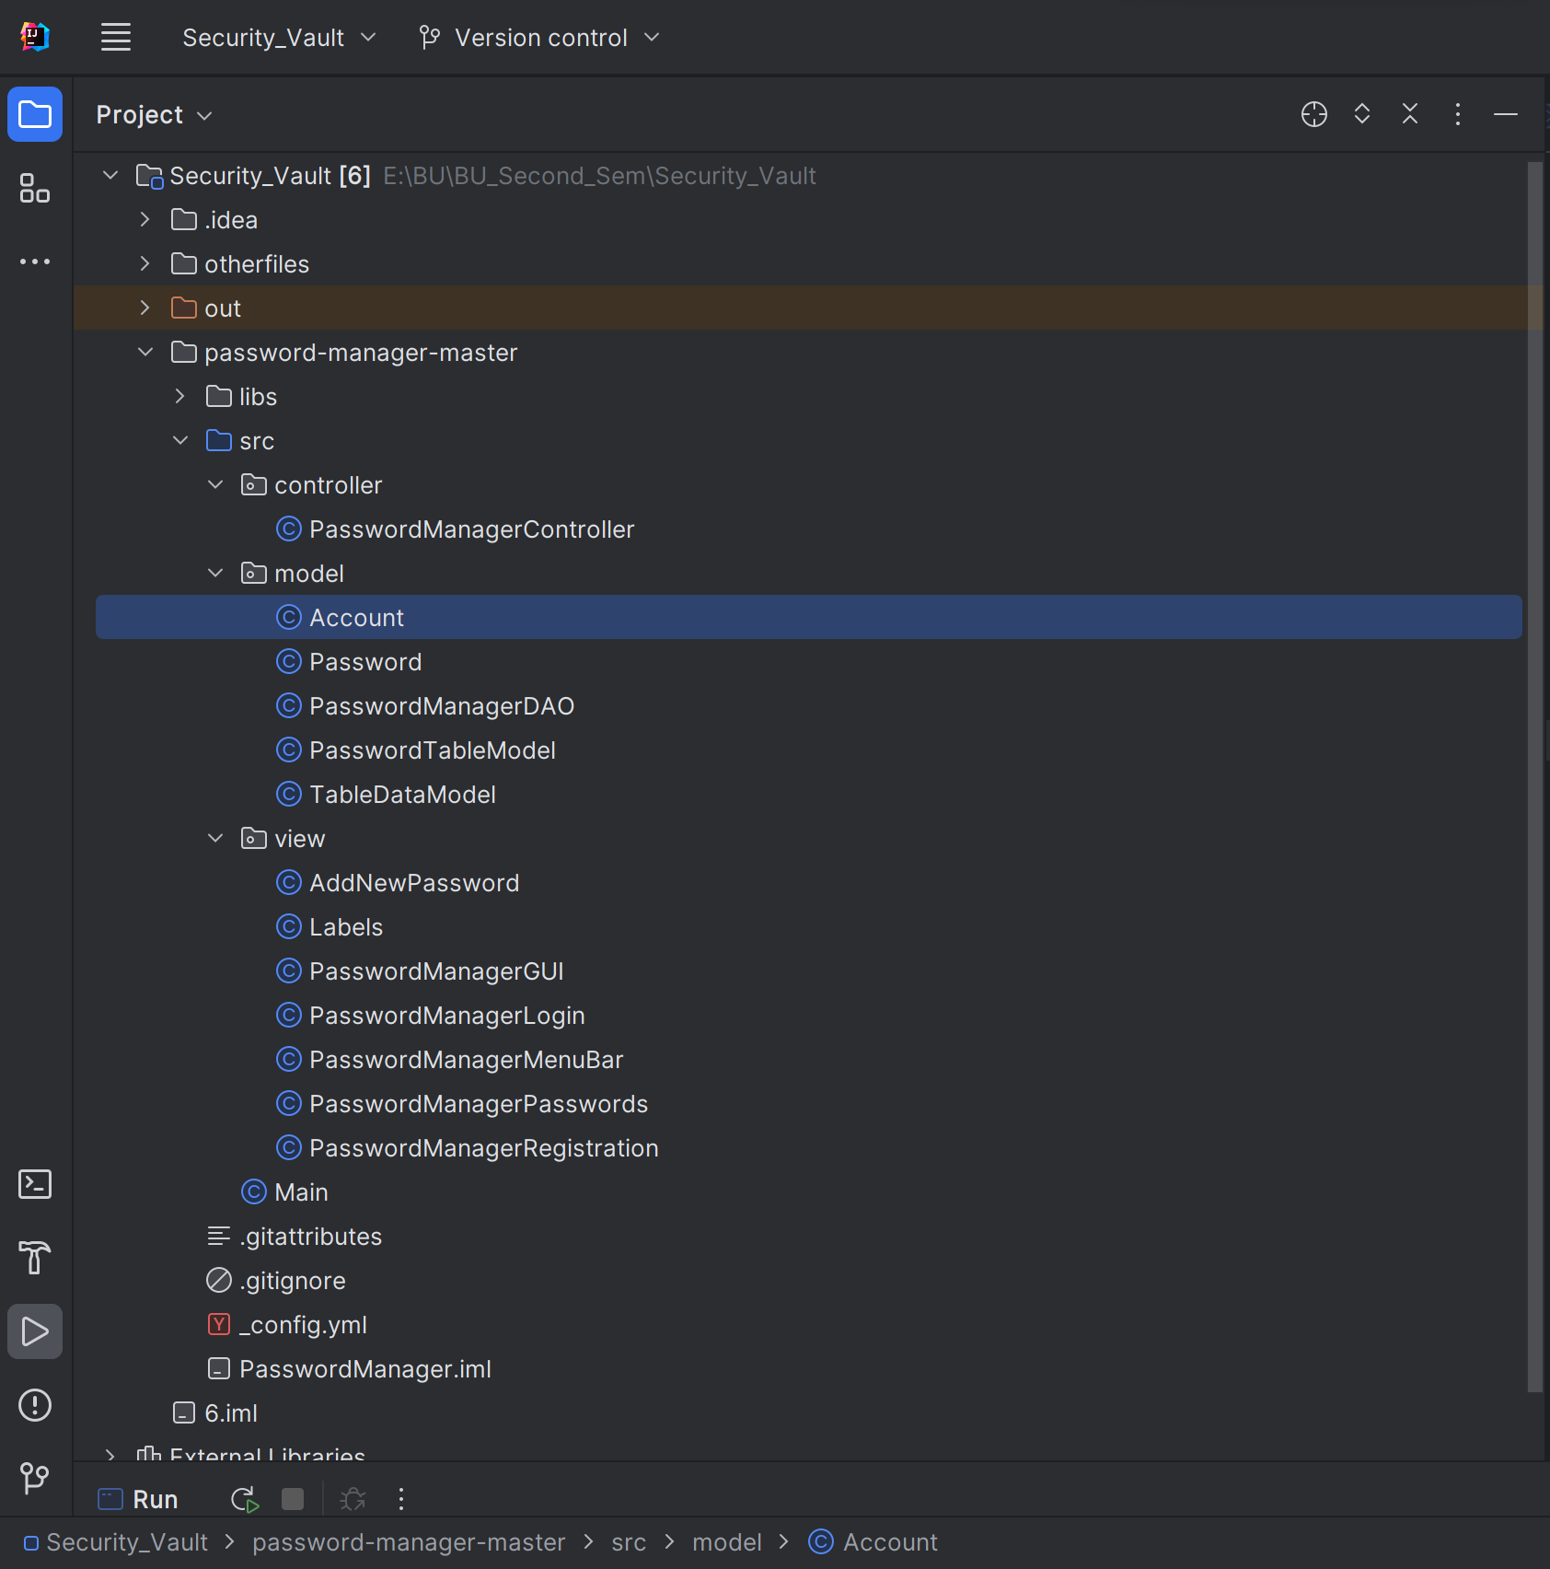
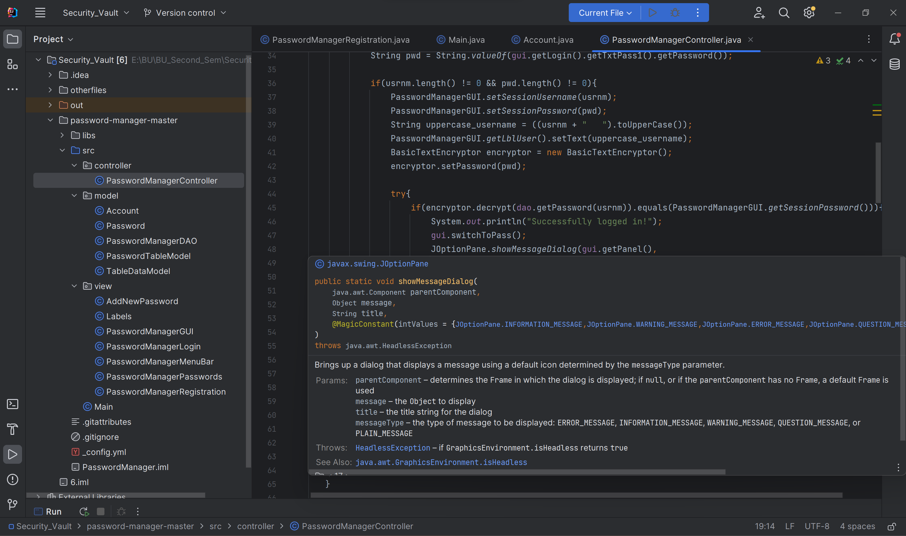
Project Codes

Slide 4
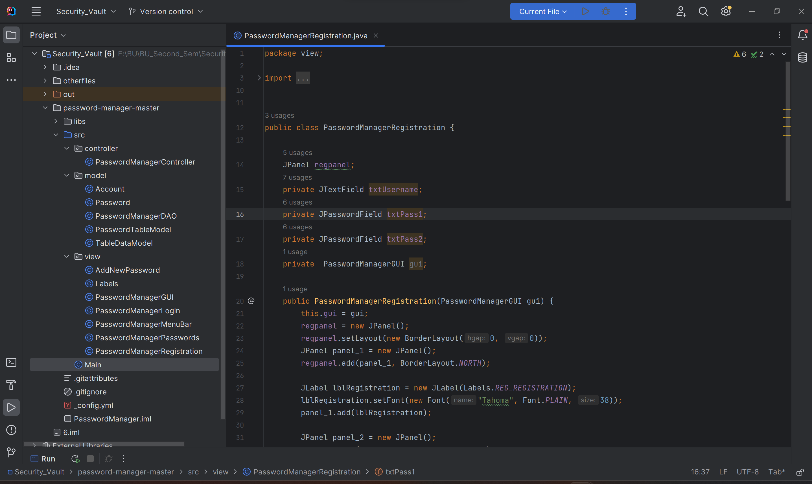
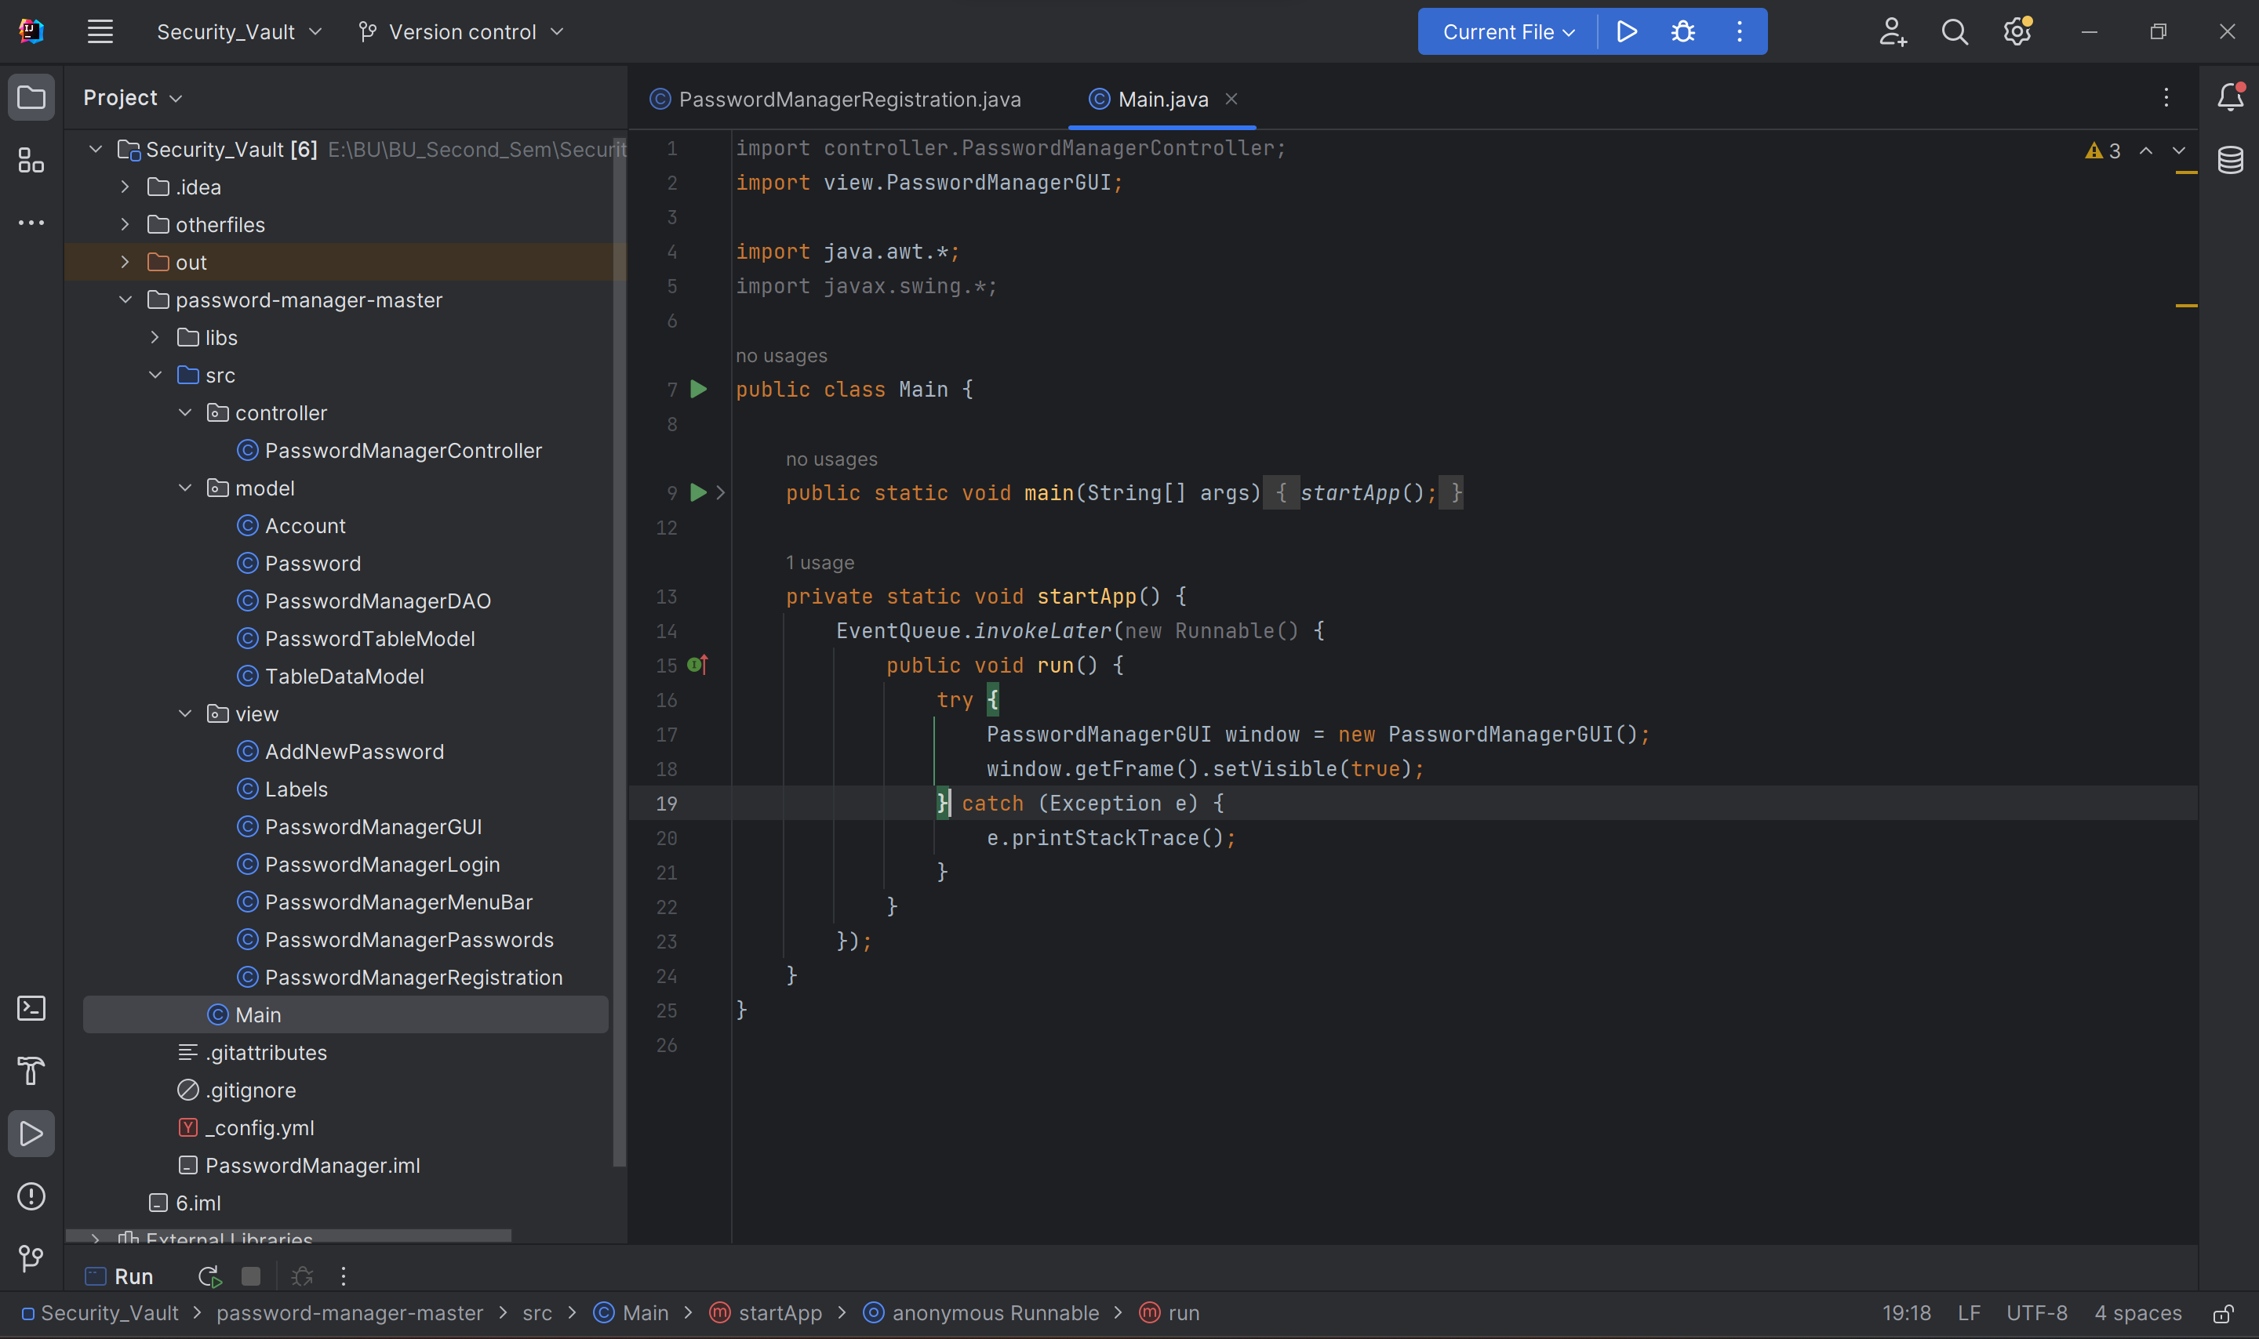
Project Codes

Slide 5
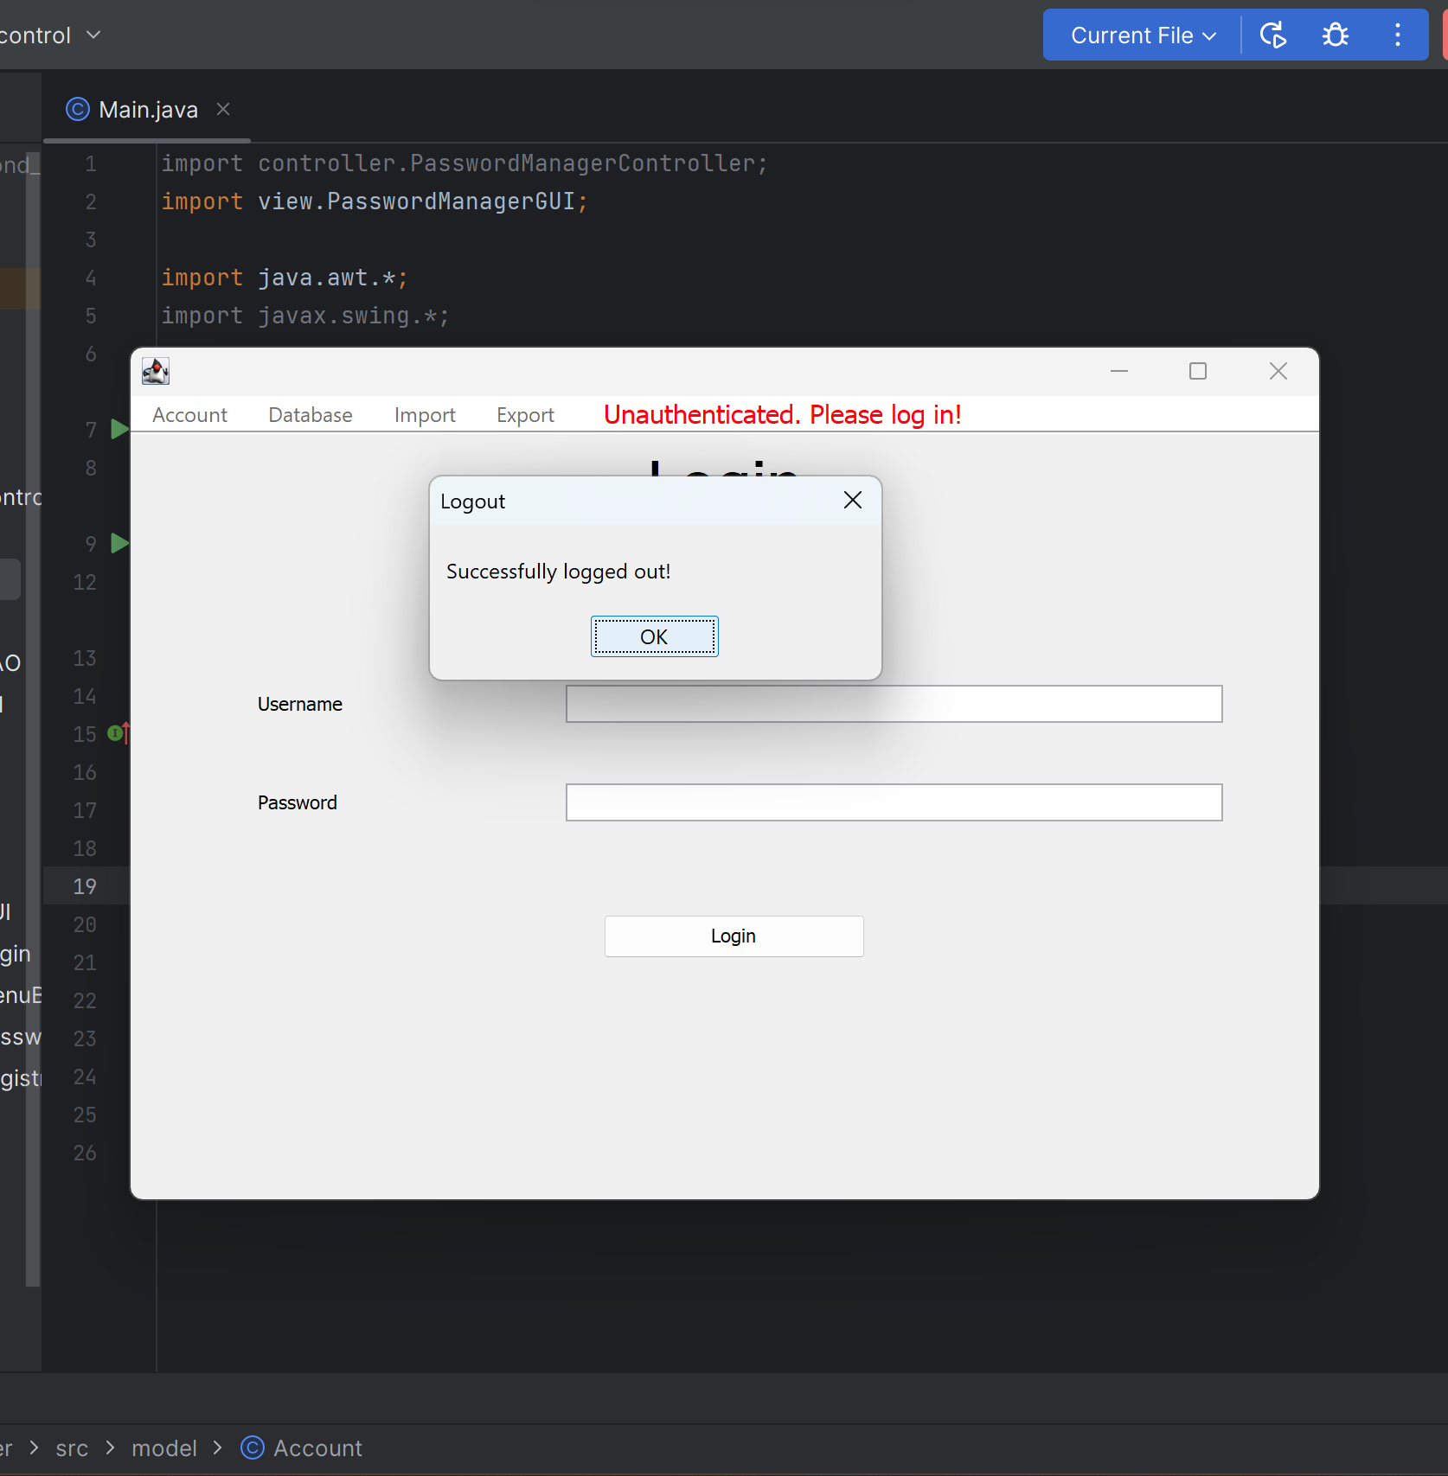
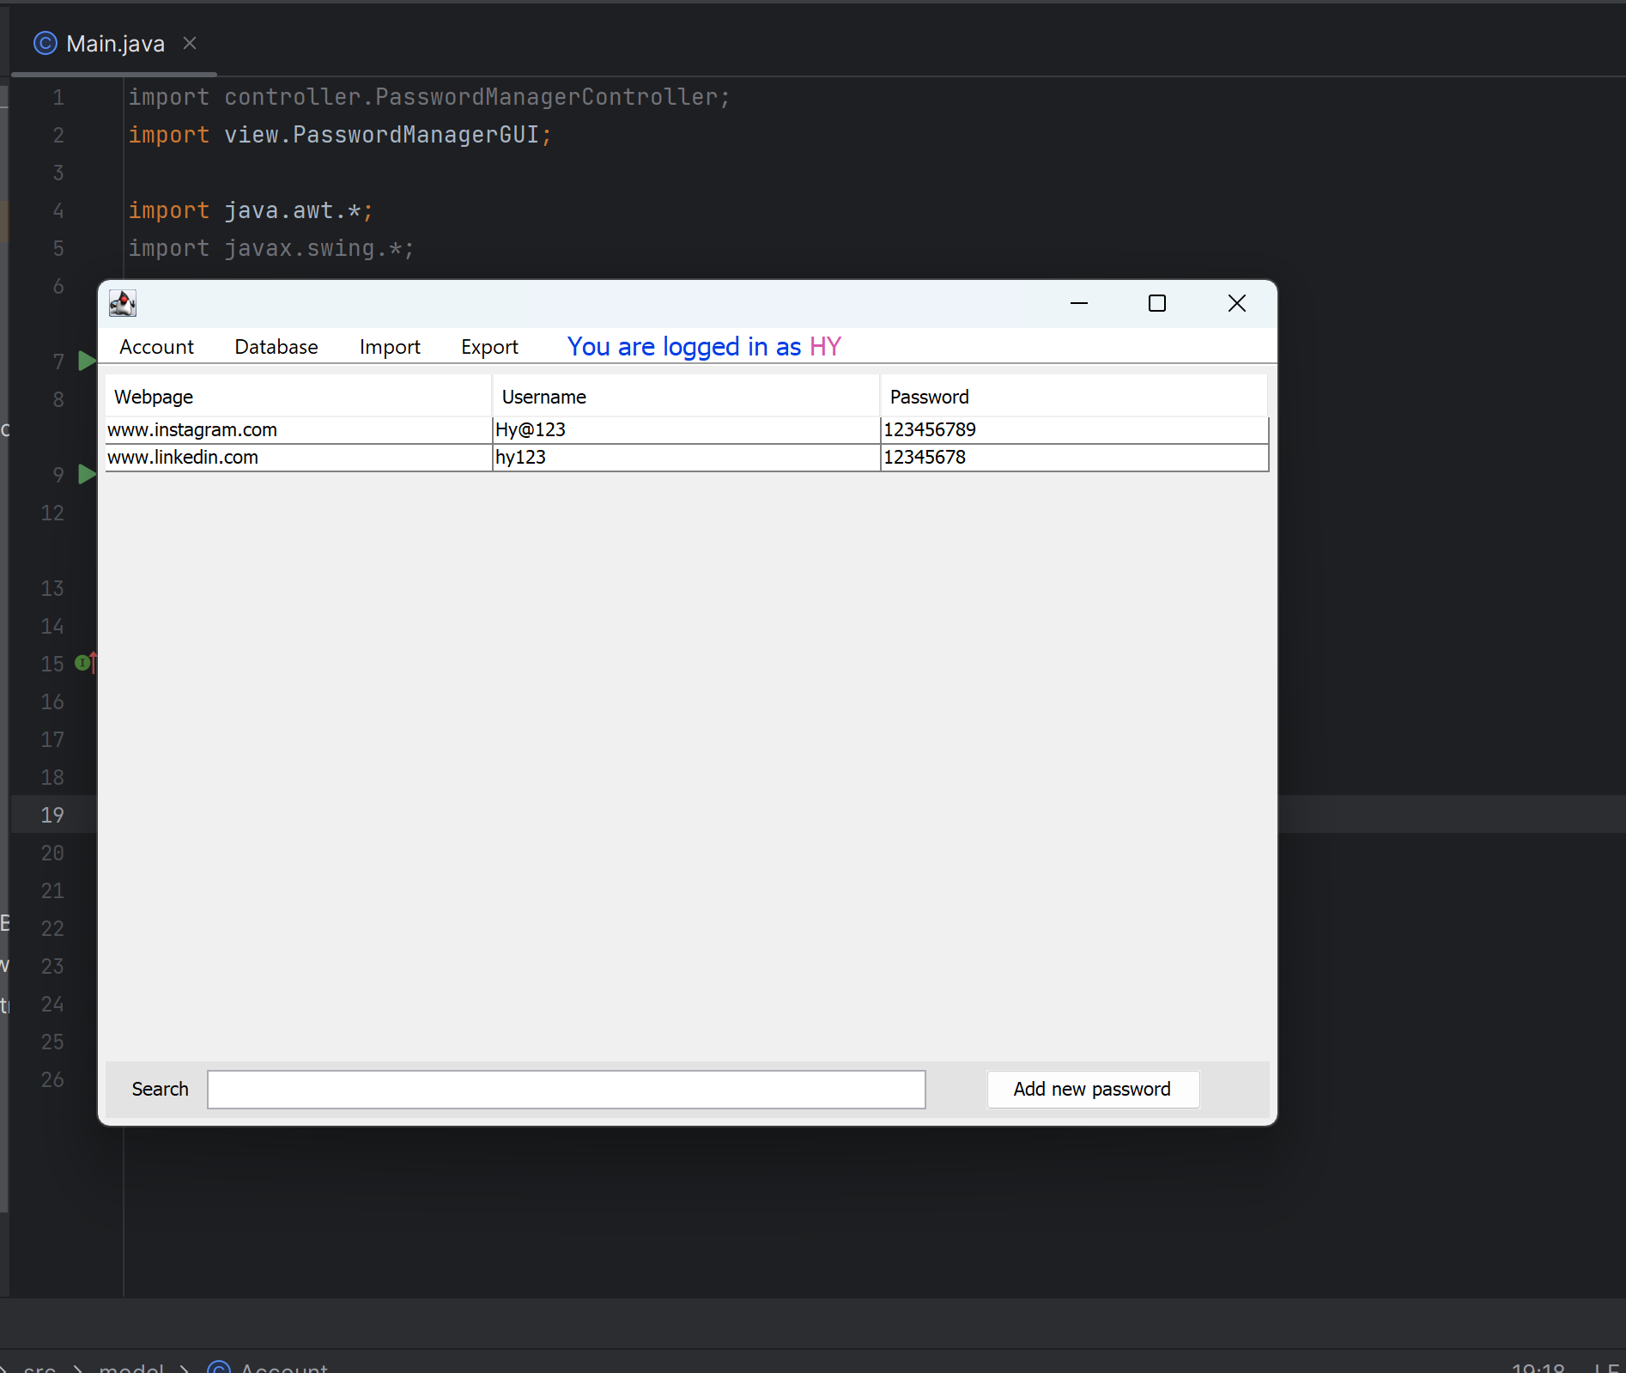
Project Codes

Slide 6
WORK COMPONENTS
work done/tools and application Used :
1Login/Register Page has been created.
2.Users registered onto Mysqlite DATABASE.
3. Alphabet-wise sorting of Passwords by clicking the respective categories.
4. Searching & Respective filtering of the above saved passwords.
5. Jasypt to encrypt users with AES algorithm.

Slide 7
REsults
1. Basic Knowledge of JavaSqlite .
2. Basic Knowledge on AES for encryption and decryption.
3. Basic Implementation of JavaSwing and other GUI related classes used.
4. AWT and Swing implementation in Java.
5. Basic Implementation of Model-view-controller structure.
6. A Basic idea on Actual Working of Password Managers on a professional level.

Slide 8
Role of each team members
PARTH SHANDILYA
(GUI) using Swing ,AWT , etc.
Basic implementation of MVC structure.
Encryption & Decryption using JaSypt.
HIMANSHU YADAV
Implementation of Mysql queries .
Implementation of Sqlite.
Integration with Swing in Java.

